Slide 1

Title IX and Athletics
Title IX and Sexual Harassment
Bullying and Hazing
Presented by
Sarah Dowdy Young, Esq.
8820 U.S. Highway 90
Daphne, AL 36526
syoung@stonecrosby.com
(251)-626-6696

Slide 2
Agenda
Overview and Background
Key Terminology,
Rules and Grievance Process
District and Employee Obligations
Investigations
Takeaways
Agenda
Title IX and Athletics
Title IX Sexual Harassment
Bullying and Hazing
Takeaways

Slide 3

WHAT IS IT? - BCPSS Policy 6.10
“No person in the United States shall, on the basis of sex, be excluded from participation in, be denied the benefits of, or be subjected to discrimination under any educational program or activity receiving Federal financial assistance.”
Title IX of the Education Amendments of 1972
(“Title IX”), 20 U.S.C. § 168.
Notes:
Title IX is the portion of the Education Amendments of 1972 that prohibits gender discrimination in educational institutions that receive federal funds, either directly or indirectly.
In brief, Title IX states: No person in the United States shall, on the basis of sex, be excluded from participation in, be denied the benefits of, or be
subjected to discrimination under any educational program or activity receiving Federal financial assistance.
As a public school system, you are likely a recipient of federal financial assistance. Any receipt of federal funds – IDEA funds, Title I funds means that Title IX is also applicable to your school system.
See Grove City College v. Bell, 104 S. Ct. 1211 (1984)
Private college that refused federal funding
Some students received federal Basic Education Opportunity Grants
DOE threatened to terminate students’ financial assistance because the college refused to execute assurances of compliance with Title IX prohibition against sex discrimination
U.S. Supreme Court ruled the recipient of grants did not trigger institution-wide coverage under Title IX 
The U.S. Supreme Court’s position in Grove City College was essentially vindicated by congressional enactment of the Civil Rights Restoration Act of 1987, which stated that if any part of an institution receives federal aid, the institution as a whole must comply with Title IX.

Slide 4
ENFORCEMENT AND POTENTIAL LIABILITY
OCR complaint
  Investigations
  Voluntary compliance-resolution agreements
  Loss of federal funding
Lawsuit
  Referral of the violation to the Department of Justice for judicial action
  Private cause of action
  No administrative remedy requirement
  No cap on award
Notes:
Who enforces Title IX and what happens if I am not in compliance? There are two main mechanisms for enforcement: OCR or lawsuit.
OCR:
If an agency believes an applicant is violating Title IX, the agency has three potential remedies:
Resolution of the noncompliance (or potential noncompliance) "by voluntary means" by entering into an agreement with the applicant, which becomes a condition of the assistance agreement; or
Where voluntary compliance efforts are unsuccessful, a refusal to grant or continue the assistance; or
Where voluntary compliance efforts are unsuccessful, referral to the Department of Justice for judicial action. 42 U.S.C. § 2000d-1.
Also, agencies may defer the decision about granting assistance pending completion of a Title IX investigation, negotiations or other action to obtain remedial relief.
Under lawsuit component:
An individual doesn’t have to exhaust their administrative remedies. Don’t HAVE to file with the OCR. Don’t have to submit a complaint under board policy.
If found liable, there is no cap on amount of damages. Also not like IDEA where money damages are only compensatory in nature.

Slide 5
Two types of Title IX Claims
There are two avenues to pursue a claim under Title IX:
Based on an institution's official policy of intentional discrimination on the basis of sex;
Seeks to hold an institution liable for teacher-on-student or student-on-student sexual harassment.
Notes:
Title IX is the portion of the Education Amendments of 1972 that prohibits gender discrimination in educational institutions that receive federal funds, either directly or indirectly.
In brief, Title IX states: No person in the United States shall, on the basis of sex, be excluded from participation in, be denied the benefits of, or be
subjected to discrimination under any educational program or activity receiving Federal financial assistance.
As a public school system, you are likely a recipient of federal financial assistance. Any receipt of federal funds – IDEA funds, Title I funds means that Title IX is also applicable to your school system.
See Grove City College v. Bell, 104 S. Ct. 1211 (1984)
Private college that refused federal funding
Some students received federal Basic Education Opportunity Grants
DOE threatened to terminate students’ financial assistance because the college refused to execute assurances of compliance with Title IX prohibition against sex discrimination
U.S. Supreme Court ruled the recipient of grants did not trigger institution-wide coverage under Title IX 
The U.S. Supreme Court’s position in Grove City College was essentially vindicated by congressional enactment of the Civil Rights Restoration Act of 1987, which stated that if any part of an institution receives federal aid, the institution as a whole must comply with Title IX.

Slide 6
Title IX and Athletics

Slide 7
STATUTORY AND REGULATORY FRAMEWORK
c
20 U.S.C. § 1681 prohibits gender discrimination in education programs that receive federal funds, either directly or indirectly.
Enforcement power is vested in the US Department of Education’s Office for Civil Rights (OCR)
Title IX does not reference athletic programs, but regulations promulgated by OCR at 34 CFR Part 106 do address athletics.
Notes:
“Federal financial assistance” is defined at 34 C.F.R. 106.2 and includes: money for buildings; money for scholarships, loans, grants, wages; grant of federal real or personal property, including surplus property; any other federal contract, agreement or arrangement assisting any educational program.
“Recipient” - includes any state or political subdivision, public or private agency, institution or organization to which federal financial assistance is extended, directly or through another recipient and which operates an education program or activity which receives such assistance.
As such, Title IX covers three major areas of high school and college athletics: athletic financial assistance, effective accommodation of student interests and abilities, and other program components.
The statute itself does not expressly refer to athletic programs. The original intent was to address inequities based on sex within educational institutions in areas such as teaching positions and enrollment. However, the congressional debates preceding the bill’s passage indicate Title IX was intended to apply to intercollegiate and interscholastic athletic programs. The regulations (34 C.F.R. Part 106) implementing Title IX contains specific provisions relating to athletic opportunities. It also permits individual institutions considerable flexibility in achieving compliance with the law.

Slide 8
3 MAJOR ATHLETIC AREAS
c
1
Effective accommodation of student interests and abilities
2
Athletic financial assistance
3
Other program component, i.e. athletic benefits and opportunities
Notes:
Title IX’s impact in athletics has evolved through a series of OCR policy interpretations and regulations. These policy interpretations have set a map out for how OCR interprets Title IX compliance issues in athletic programs.
(don’t have to mention all of these, but provided if needed for more information and to review)
34 C.F.R. § 106.41(c)(1);
Dear Colleague Letter: Part Three of the Three-Part Test (April 20, 2010), available at http://www.ed.gov/ocr/letters/colleague-20100420.html;
Dear Colleague Letter: Athletic Activities Counted for Title IX Purposes (September 17, 2008), available at http://www.ed.gov/ocr/letters/colleague-20080917.pdf;
Dear Colleague Letter: Title IX Athletics Three-Part Test (March 27, 2008), available at http://www.ed.gov/ocr/letters/title-ix-2008-0327.pdf;
Dear Colleague Letter: Further Clarification of Intercollegiate Athletics Policy Guidance (July 11, 2003), available at http://www.ed.gov/ocr/title9guidanceFinal.html;
Dear Colleague Letter: Clarification of Intercollegiate Athletics Policy Guidance: The Three-Part Test (January 16, 1996), available at http://www.ed.gov/ocr/docs/clarific.html; and
Title IX Policy Interpretation: Intercollegiate Athletics (December 11, 1979), available at http://www.ed.gov/ocr/docs/t9interp.html.
The first policy interpretation set the stage for the three coverage areas in athletics.
“1979 Policy Interpretation”
First discussion of compliance in three parts in the area of athletic programming:
1. Compliance in meeting the interests and abilities of male and female students- the athletic interests and abilities of male and female students must be equally effectively accommodated.
2. Financial assistance (aka scholarships and other funds) and
3. Compliance in other program areas- “the laundry list” (equivalent treatment, benefits and opportunities)

Slide 9

HOW IS IT APPLIED TO ATHLETICS?
Overall athletic program of a school – not just to specific sports or teams
Intramural sports, physical education courses, and other school-sponsored athletic programs
Notes:
The regulation (34 C.F.R. Part 106) implementing Title IX contains specific provisions regarding athletic opportunities. Title IX does not require athletic programs for male and female students be identical, but it does require equity. Importantly: Title IX is analyzed under the program as a whole. Not sport compared to sport. Whether a school’s entire athletic program is equitable depends on multiple factors, including:
Whether the selection of sports and levels of competition effectively accommodate the interests and abilities of members of both sexes;
The provision of equipment and supplies;
Scheduling of games and practice time;
Travel and per diem allowance;
Opportunity to receive coaching and academic tutoring;
Assignment and compensation of coaches and tutors;
Provision of locker rooms, practice and competitive facilities;
Provision of medical and training facilities and services;
Provision of housing and dining facilities and services; and
Publicity.
Which activities are covered?
The USDE has stated the regulations prohibiting sexual discrimination in interscholastic and intercollegiate athletic programs applies to K-12 schools. OCR has indicated when it conducts an investigation to determine if a school district provides equal athletic opportunities as required by the Title IX regulations, OCR considers several factors related to the activity’s structure, administration, team preparation, and competition, when determining whether an activity is a sport that can be counted as part of the school district’s interscholastic program.
Considering the unique aspects of the basic operation of specific sports, OCR considers whether the activity is structured and administered in a manner consistent with established interscholastic varsity sports in the school district’s athletic program, including:
Whether the operating budget, supports services, and coaching staff are administered by the athletic department or another entity, and are provided in a manner consistent with established varsity sports.
Whether the participants in the activity are eligible to receive athletic scholarships and athletic awards if available to athletes in established varsity sports.
Whether the practice opportunities are available in a manner consistent with established varsity sports in a school district’s athletic program.
Whether the regular season competitive opportunities differ quantitatively and/or qualitatively from established varsity sports.
If pre-season and/or post-season competition exists for the activity, whether the activity provides an opportunity for student athletes to engage in the pre-season and/or post-season competition in a manner consistent with established varsity sports.
Whether the primary purpose of the activity is to provide athletic competition at the interscholastic varsity levels, rather than to support or promote other athletic activities.

Slide 10
EQUIVALENCE OVERVIEW
Test of compliance is equivalence.
Benefits, opportunities and treatment of each sex must be equal or equal in effect.
There must be no disparity between boys’ and girls’ programs.
  That does not mean they must be the same.
  Nondiscriminatory factors can account for differences, such as the different equipment needs for the football and field hockey teams.
Notes:
For all of the program components (except financial aid: AREA 2 OF THREE AREAS), the basic test of compliance is equivalence. See 34 C.F.R. § 106.41(c)(2)-(10). That is, the benefits, opportunities and treatment of each sex must be equal or equal in effect.
In other words…(next slide)

Slide 11
Components
Participation/
Accommodation
Athletic Financial Assistance
Treatment/
Other Components
3-Prong Test
Scholarships
Other funding issues:
Municipal
contribution
Booster Clubs
Donations
  mu
Facilities
Equipment
Schedules
Publicity
Coaching
Travel/allowance
Recruitment
Tutoring
Medical/training
Housing/Dining
Proportionality
History and Practice
“Showing Growth” and continued expansion
Interest and Abilities
Effective accommodations
Notes:
In other words for columns 1 and 3, OCR’s test of compliance is “equivalence” or looking at each of those areas and determining whether there is any disparity between programs, treatment and other components.
(Regarding to Area 2: financial aid-The test is not equivalence or equal $ between boys and girls). Considerations for financial assistance compliance under Title IX will be discussed in a few minutes.

Slide 12
AREA 3
OTHER PROGRAM COMPONENTS
EQUIPMENT AND SUPPLIES
Not $ girls = $ boys
Equivalent amount, quality and suitability of equipment
LOCKER ROOMS, PRACTICE, AND COMPETITIVE FACILITIES
Availability, exclusivity, quality
Notes:
Another area of compliance is the relevant comparison between overall benefits provided to all girls’ teams and the overall benefits provided to all boys’ teams. While discrepancies in specific same-sport benefits (i.e., boys’ soccer vs. girls’ soccer) may indicate potential compliance problems, Title IX is intended to ensure overall equivalence in athletic opportunities and benefits, not single sport equivalence. Evaluation in this area involves a subjective balancing test.
Equipment and Supplies. Equipment and supplies include but are not limited to uniforms and apparel, sport-specific equipment and supplies, instructional devices, and conditioning and weight-training equipment. Title IX applies to practice and game uniforms, shoes, and warm-up suits. Equipment includes bats, sticks, rackets and equipment set up and taken down for practice. Conditioning and weight-training equipment includes weights, water bottles, sweat-bands, braces, etc.
B. Locker Rooms, Practice and Competitive Facilities This is one of the most common program areas in which there are usually differences between the benefits provided to women’s and men’s athletic programs. In determining compliance with Title IX consider:
1. The quality and availability of the facilities provided for practice and competitive events
2. The exclusivity of use of the facilities provided for practice and competitive events
3. The availability and exclusivity of locker rooms
4. The quality of the locker rooms
5. The maintenance of practice and competitive facilities
6. The preparation of facilities for practice and competitive events

Slide 13
AREA 3
OTHER PROGRAM COMPONENTS
TRAVEL AND DAILY ALLOWANCE
Method, length of stay, per diem amounts
SCHEDULING OF GAMES AND PRACTICE TIMES
Number of events, length of practices, time of day
COACHING
Opportunity to receive, assignment, compensation
Notes:
C. Travel and Daily Allowance. There are five factors to consider when determining Title IX compliance in this area:
1. The method of transportation;
2. The housing furnished during travel;
3. The length of stay before and after competitive events;
4. The per diem allowance provided to the teams; and
5. The dining allowance and arrangements provided to the teams.
D. Scheduling of Games and Practice Times. When determining compliance with Title IX, consider:
1. The number of competitive events offered per sport;
2. The number and length or practices;
3. The time of day competitive events are scheduled;
4. The time of day practices are scheduled; and
5. The number of pre-season and post-season competitive opportunities.
E. Coaching. (Years of Experience, Quality, Compensation and Assignment of Coaches.) OCR has combined two of the areas which are defined in the Title IX Federal regulations - opportunity to receive coaching and the assignment and compensation of coaches - into one investigative category. See OCR 1996 Clarification, supra at Note 1. The focus of the OCR inquiry in this area is “whether, in an overall fashion, women athletes at a school have access to the same quality and expertise of coaching as do, in an overall manner, the male athletics participants at the school.”

Slide 14
What about Student Athlete Discipline and Title IX?
Does the Discipline have to be equal?

Slide 15

Gruver v. Louisiana State University
July 2019
An unorthodox and potentially precedent-setting lawsuit against Louisiana State University alleges officials ignore fraternity hazing but protect sororities.
Max Gruver -- an 18-year-old who died in 2017 after being forced to chug hard liquor during fraternity hazing ritual– parents alleged school’s practice violated Title IX.
Contended that because the university has essentially protected sorority members by limiting hazing among them, it has violated Title IX by not doing the same for fraternities.
The parents' argument is that fraternity members and pledges at the state's flagship institution are far more at risk than their sorority counterparts because the university disregarded the dangerous and sometimes fatal hazing activities that occur among men in Greek life and cracked down on the women more severely.
“[u]nlike LSU fraternities, LSU sororities, which restrict membership to female students, do not have a culture or long-documented history of dangerous hazing and misconduct,” and “when LSU has received reports of hazing at its sororities, the sanctions LSU has imposed on the sororities have been significantly greater in length and degree than sanctions LSU generally imposes on fraternities for comparable misconduct.”
“Plaintiffs allege LSU has a policy of treating sorority hazing complaints more harshly than fraternity complaints. Plaintiffs further argue that, because this practice is grounded in outdated stereotypes of men, it is intentional discrimination that forces males to seek benefits of Greek Life with greater risk of injury.”
“Plaintiffs' Title IX claim in this case is unquestionably based on LSU's alleged policy of intentional discrimination on the basis of sex.”
Notes:
Legal observers said this interpretation of Title IX stretches its boundaries and could prompt others to challenge colleges' disciplinary measures with legal arguments that have not applied under the law.

Slide 16
Lozano v. Baylor University
September 2019
Female Student allegedly physically assaulted by football player alleged that university’s selective enforcement of reports of domestic abuse and sexual assault created heightened risk of assault which subjected her to a sexually discriminatory education environment under Title IX.
Alleged that university had policy of no or little discipline of football players through separate system of discipline for football team that involved multiple coaches and administrators and insulated football players from appropriate disciplinary consequences, which posed a risk to campus safety and substantially increased risk that women would be assaulted by members of the football team.
Baylor “reinforced the perception that rules applicable to other students are not applicable to football players” and thereby affirmatively increased the likelihood that Lozano, and other female students, would be assaulted by football players, who knew they were unlikely to face any repercussions from their actions.”

Slide 17
Lozano v. Baylor University
September 2019
Cited to Gruver and finding that Title IX claims are plausible based on selective enforcement of school disciplinary rules based on gender stereotypes.
Cited to J.H. v. Sch. Town of Munster (Indiana case) where it was alleged that school purposefully ignored complaints of hazing in male swimming program based on gender stereotypes, for example, that “boys will be boys.”
The question is whether a school “intended to treat [students] differently on the basis of their sex.”

Slide 18
What about Student Athlete Discipline and Title IX?
Does the Discipline have to be equal?
MAYBE….!

Slide 19
New Title IX Regulations:
Teacher on Student
Student on Student

Slide 20
Discrimination= Treating People Differently
Discrimination is the act of treating people differently based on a protected characteristic (or stereotypes based on that characteristic)
  Focus on access to education opportunities, resources, programs, and activities
  Disparate treatment in the workplace/school
  Disparate impact claims (neutral policies that have discriminatory impacts

Slide 21
Common Types of Protected Traits
Race
Color
Religion
Sex (gender)
Military status
National origin
Disability
Age
Ancestry
Marital status
Pregnancy
Genetic information

Slide 22
Sex Discrimination and Harassment
Title IX
  “No person in the United States shall, on the basis of sex, be excluded from participation in, be denied the benefits of, or be subjected to discrimination under any education program or activity receiving Federal financial assistance…”
TITLE IX: The Law

Slide 23
What does Sex Mean?
Biological sex
Gender
Sex stereotyping
Sexual orientation**
“Sex” as a verb

Slide 24
Title IX Sexual Harassment Timeline
1972
Title IX enacted
1974
First Title IX Regulations Issue
1980
Title IX Enforcement transferred to the Office of Civil Rights (OCR
1992
SC recognizes student right to $ damages for sexual harassment (Franklin v. Gwinnett County School)
1997
OCR issues guidance on sexual harassment recognizing school system responsibility to respond
1998
SC sets standard for teacher-on-student harassment liability as deliberate indifference after “actual notice”
1999
SC adds to requirement narrow definition of “sexual harassment” Monroe Co. Bd. Of Educ.

Slide 25
Final Title IX Regulations Apply to Employees
Recipients that are subject to both Title VII and Title IX must comply with both
  “Deliberate indifference” standard applies - Because Title IX recipients are “in the business of education”

Slide 26
Sexual
Harassment
• Employee quid pro
quo
• Hostile environment
(newly defined)
• VAWA “big four”

Slide 27
New Definitions of Sexual Harassment:
BCPSS Policy 6.12
Sexual harassment means conduct on the basis of sex that satisfies one or more of the following:
  Quid pro quo – An employee of the recipient conditioning the provision of an aid, benefit, or service of the recipient on an individual’s participation in unwelcome sexual conduct
  Hostile environment – Unwelcome conduct determined by a reasonable person to be so severe, pervasive, and objectively offensive that it effectively denies a person equal access to the recipient’s education program or activity; or
  Clery crimes – Sexual assault, dating violence, domestic violence, or stalking [Clery regulatory definition cites omitted]

Slide 28
Quid Pro Quo
Codified: Severity and harm presumed
New: Only an employee (not a volunteer, another student, etc.)
Definition: An employee of the recipient conditioning an aid, service, or benefit of the recipient on an individual’s participation in unwelcome sexual conduct

Slide 29
Hostile Environment:
What Changed?
Old Definition (OCR Guidance )
New Definition (Final Rule)
Unwelcome conduct
Determined by a reasonable person
To be severe, pervasive, or persistent, and to interfere with or limit a student’s ability to participate in or benefit from school services, activities, or opportunities
Unwelcome conduct
Determined by a reasonable person
To be so severe, pervasive, and objectively offensive that it effectively denies a person’s equal access to the recipient’s education program or activity

Slide 30
VAWA “Big Four”
Sexual Assault 20 U.S.C. 1092(f)(6)(A)(v)
Domestic Violence 34 U.S.C. 12291(a)(8)
Dating violence 34 U.S.C. 12291(a)(10)
Stalking 34 U.S.C. 12291(a)(30)

Slide 31
“In a program or activity”
“Educational program or activity” includes locations, events, or circumstances over which the recipient exercised substantial control over both the respondent and the context in which the sexual harassment occurs…

Slide 32
When and how must a school respond to sexual harassment?
A recipient with actual knowledge of sexual harassment in an educational program or activity of the recipient against a person in the United States, must respond promptly in a manner that is not deliberately indifferent. A recipient is only deliberately indifferent if its response to sexual harassment is unreasonable in light of known circumstances.

Slide 34
Break it Down…
Actual knowledge =
  notice of sexual harassment or allegations of sexual harassment to a recipient’s:
    Title IX Coordinator, or
    Any official of the recipient who has authority to institute corrective measures on behalf of the recipient, or
    To any employee of an elementary or secondary school 34 C.F.R. § 106.30(a)

Slide 35
Break it Down…

Slide 36
Break it Down…
Deliberate Indifference: “[T]he response must amount to deliberate indifference to discrimination. The administrative enforcement scheme presupposes that an official who is advised of a Title IX violation refuses to take action to bring the recipient into compliance. The premise, in other words, is an official decision by the recipient not to remedy the violation.”

Slide 37
Retaliation
Specifically prohibited in the final rules
Retaliation defined in part: “No recipient or other person may intimidate, threaten, coerce, or discriminate against any individual for the purpose of interfering with any right or privilege secured by Title IX or this part, or because the individual has made a report or complaint, testified, assisted, or participated or refused to participate in any manner in an investigation, proceeding, or hearing under this part…” 34 C.F.R. § 106.71

Slide 38
Retaliation
Report this immediately to the Title IX Coordinator
Is there already a no-contact order and, if not, do you want one?
Adverse action against an individual
Abuse, violence, threats, and intimidation
More than just someone expressing their opinion

Slide 39

Other
Requirements:
Designated “Title IX
Coordinator “

Slide 40
Bullying and Hazing

Slide 41
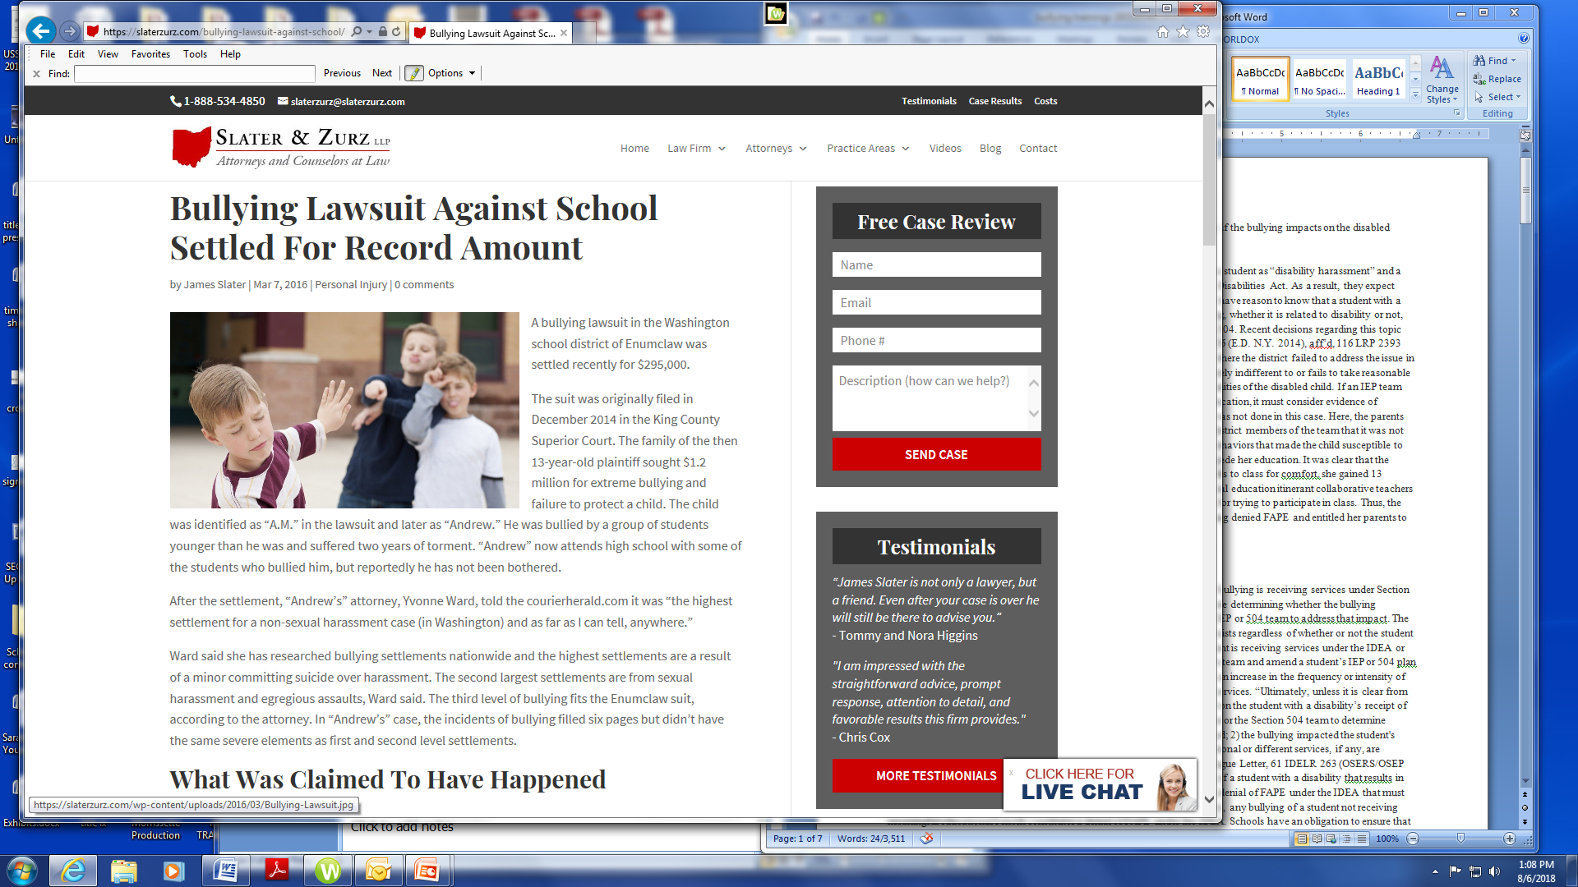

Slide 42


Slide 43
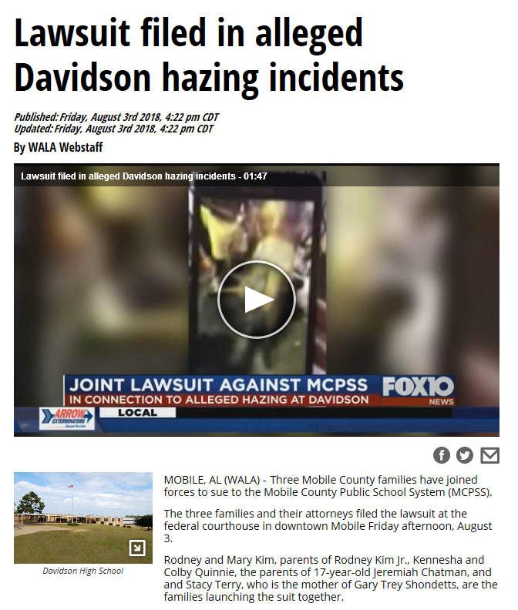


Slide 44
What is Bullying?
www.Stopbullying.gov:
Unwanted, aggressive behavior among school-aged children that involves a real or perceived power imbalance. The behavior is repeated, or has the potential to be repeated, over time.

Slide 45
What is Bullying?
In order to be considered bullying, the behavior must be:
  Aggressive and includes:
  An Imbalance of Power: Kids who bully use their power
    such as physical strength,
    access to embarrassing information,
    or popularity—to control or harm others.
  Repetition
    Bullying behaviors happen more than once or have the potential to happen more than once.

Slide 46
Laws that Apply to Bullying Claims
Alabama Bullying and Harassment and Prevention Act
  Alabama Code §§ 16-28B-1 et seq.
  Jamari Terrell Williams Student Bullying Prevention Act
  Board Policy provisions and Student Code of Conduct
Alabama Anti-Hazing Law
  Alabama Code § 16-1-23
Title IX of the Education Amendments Act of 1972
Title VI of the Civil Rights Act of 1964
The Individuals with Disabilities Education Act (IDEA)
Section 504/ADA
The Federal Constitution – State-created Danger

Slide 47
Alabama Bullying Prevention Act
Previously named the Student Harassment Prevention Act
2018- Jamari Terrell Williams Bullying Prevention Act
  Expanded Act to better identify and define “bullying”
  Includes cyberbullying in the definition of bullying.
  Includes bullying, intimidation, violence and threats of violence that occur off school property.
Notes:
The legislation is named after a Montgomery 5th grader who took his own life after he was bullied. His mother has started a foundation to work with City officials, schools, churches, and other organizations to put an end to bullying and prevent suicide in children and young adults.

Slide 48
Alabama Bullying Prevention Act
BCPSS Policy 6.25
Bullying is:
  A continuous pattern
  Intentional behavior
  On or off of school property,
  Whether cyberbullying or written, electronic, verbal, or physical acts
  Motivated by any characteristic of a student
  That falls into one of the categories of personal characteristics contained in the Board Policy
  To constitute bullying, a pattern of behavior may do any of the following:
  Place a student in reasonable fear of harm
  Substantially interfere with the educational performance, opportunities, or benefits of a student.
  Substantially disrupt or interfere with the orderly operation of the school
  Create a hostile environment in the school
  Be sufficiently severe, persistent, or pervasive enough to create an intimidating, threatening, or abusive educational environment for a student.
Alabama Code § 16-28B-3(1)(a)-(e)

Slide 49
Alabama Bullying Prevention Act
Hostile environment.
  The perception by an affected student or victim that the conduct of another student constitutes a threat of violence or bullying and that the conduct is objectively severe or pervasive enough that a reasonable person, under the circumstances, would agree that the conduct constitutes bullying, threat of assault, or assault.
Ala. Code § 16-28B-3

Slide 50
Alabama Law: Hazing
Definition:
  1. Any willful action taken or situation created:
    whether on or off any school
    which recklessly or intentionally endangers the mental or physical health of any student, OR
  2. Any willful act:
    On or off any school
    By any person alone or acting with others in
    Striking, beating, bruising, or maiming; (or any assault upon any such students)
    Made for the purpose of committing any of the acts, or producing any of the results to such student as defined in this section.
    BUT
  3. The term hazing as defined in this section does not include:
    Customary athletic events or similar contests or competitions.
    Corporal punishment administered by officials or employees of public schools when in accordance with policies adopted by local boards of education.
    HAZING IS limited to those actions taken and situations created in connection with initiation into or affiliation with any organization.
  Alabama Code § 16-1-23(a)

Slide 51
Alabama Law: Hazing
No person shall engage in hazing
No person shall knowingly permit, encourage, aid or assist any person in hazing
Class C misdemeanor
Forfeiture of public funds, scholarships, or awards
Alabama Code § 16-1-23

Slide 52
BCPSS Athletic Handbook
Hazing is INTOLERABLE in ANY FORM and will result in disciplinary action.

Slide 53
Alabama Educator Code of Ethics
BCPSS Policy 5.1- All employees are expected to follow the Alabama Educator Code of Ethics
Standard 2: Trustworthiness
An educator should exemplify honesty and integrity in the course of professional practice.
Ethical conduct includes, but is not limited to, the following:
  Properly representing facts concerning an educational matter in direct or indirect public expression
  Advocating for fair and equitable opportunities for all children
  Embodying for students the characteristics of intellectual honesty, diplomacy, tact, and fairness. BE A ROLE MODEL

Slide 54
Alabama Educator Code of Ethics
Standard 4: Teacher/Student Relationship
An educator should always maintain a professional relationship with all students, both in and outside the classroom.
Ethical conduct includes, but is not limited to, the following:
  Fulfilling the roles of trusted confidante, mentor, and advocate for students’ growth.
  Nurturing the intellectual, physical, emotional, social, and civic potential of all students.
  Providing an environment that does not needlessly expose students to unnecessary embarrassment or disparagement.
  Creating, supporting, and maintaining a challenging learning environment for all students.
  Unethical conduct includes, but is not limited to, the following:
    Engaging in harassing behavior on the basis of race, gender, national origin, religion, or disability.

Slide 55
Takeaways

Slide 56
Key Takeaways
Board Policies
  Overlapping Definitions – Title IX; Bullying and Prevention
Study updated Title IX grievance procedures in the 2020-2021 Student Handbook
Study the Baldwin County Public School System Athletic Handbook
  All discipline and student athlete treatment should be consistent with the system-wide handbook
Understand the definitions of sexual harassment, bullying, hazing
Know to whom you should report any complaints of sexual harassment, bullying, and/or hazing (whether witnessed yourself, or reported to you by someone else)
Recognize or know responsibility to report any acts of retaliation

Slide 57
Employee Obligations
Know who the District Title IX Coordinator is (their information will be posted on the school’s website)
Comply with all relevant Board Policies and Procedures, including Athletic Handbook
Seek guidance from Athletic Directors and Administrators
Act in a manner that lessens the harm
  Response
  Timely
  Reasonable
Follow the Alabama Educator Code of Ethics
  Be a role model
  Act not to be deliberately indifferent
Participate in investigation/work with the Title IX Coordinator
Document knowledge and who you have spoken to
Confidentiality

Slide 58
Questions?

