Slide 1
Pre-AP Notebook Page 1
AP World History: Modern Basics
AP World History: Modern – Unit 0

Slide 2
The AP Test Components
A score of 3/5 or better on the AP Test earns college credit; specific to history credit if 4/5 or better
The AP Test has a Multiple-Choice Section (4 options drawn from a quote or
image) and a free-response component comprised of Short Answer Questions
(SAQs), a Long Essay Questions (LEQ), and a Document-Based Question (DBQ)
For SAQs, you must answer questions using either your
own knowledge of the topic, or a provided image or quote
For the LEQ, you must rely solely on your knowledge of history to
write a standard, 5-paragraph essay on your choice of three questions
For the DBQ, you rely both on your knowledge of history, as well
as 7 provided historical documents to write a 5-paragraph essay

Slide 3
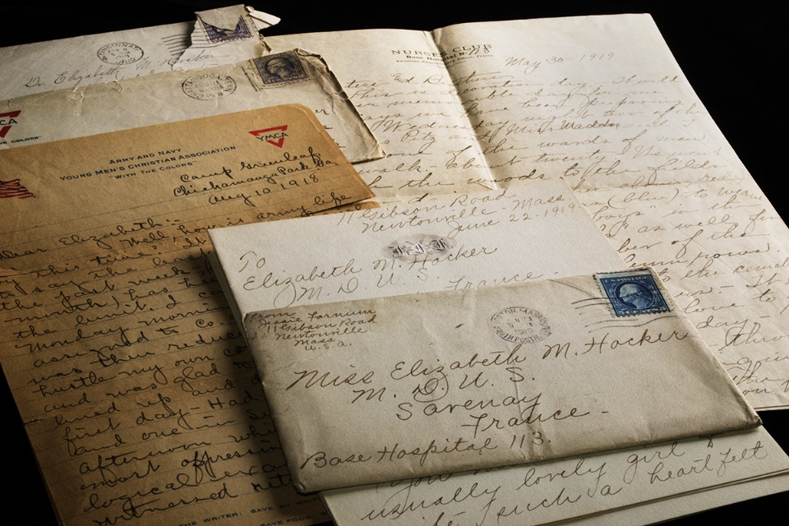
Basic Historical Terminology
Below are some terms that are integral to the course, and every AP History student should know:
A primary source is a written source, image, or artifact FROM the time period
being studied (i.e., a painting, poem, artifact, etc., from the 19th century)
A secondary source is a written source about some-one or something
from ANOTHER time period (i.e., a textbook writing about Einstein)
In social science (history in this case), the term syncretizing is often used to
indicate a blending of ideas or beliefs (i.e., when a religion or philosophy
adopts or otherwise incorporates parts of another religion or philosophy)

