Slide 1
Local School Purchasing Documentation Requirements
July 25, 2024
Donna Daw,
Internal Auditor
Baldwin County Public Schools
Notes:
Line spacing + Page numbers

Slide 2
Agenda
01 Introduction
02 Checks
03 P-Cards
04 Summary
05 Closing

Slide 3
Introduction
Local School Accounting
Compliance Requirements
01
Alabama Department of Education
Financial Procedures for Local Schools
https://www.alabamaachieves.org
Baldwin County Public Schools
Local School Accounting Finance Manual
https://www.bcbe.org
7/24/2024
3

Slide 4
Check - Approval Requirements
Products
Requisition – Purchase Order
Field Trip Admissions
Travel Tracker Approval
Refunds
Approved Refund Form
Travel
Leave Request Form
Services
Contract
02

Slide 5
Requisition
Purchase Order
Detailed Invoice
Submitted by Employee
Created by Bookkeeper
Provided by Vendor
School Name
Vendor Name & Address Date Detailed Item Description Quantity Unit cost Total Activity Name/Number Teacher name/signature
* Quote-Beneficial
New Vendor: W-9 Required
Verify Available Balance
Verify Allowable w/Funding
Assign GL Code
Create in NextGen
Vendor Name/Address
School Name/Address Purchase Order Number
Invoice Date
Invoice Number
Detailed Item Description
Quantity
Unit Cost
Total
Signature of Originator
Approved by Principal
Purchase of Products
7/24/2024
5

Slide 6
Field Trip Admissions
Approved travel tracker Form
Venue Quote
Request for Check
Invoice/Receipt from Venue
Charter/Coach bus companies require a contract.
The contract must be approved by the Legal Department.
7/24/2024
6

Slide 7
Refund Request form submitted
Approved by principal
Processed by Bookkeeper
Parent/Student Refunds
Copy of Original Receipt Required.
Current Year – Reduce original revenue code.
Prior Year – Contact LSA Staff
7/24/2024
7

Slide 8
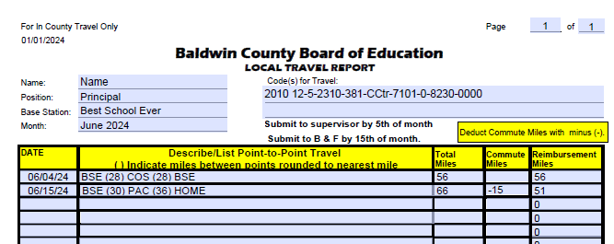
Employee Travel Reimbursements Local Travel
Make sure current form is used.
File monthly
Include point-to-point travel
Deduct commute miles
Local travel – Object 381
Purchase Order not required

Slide 9
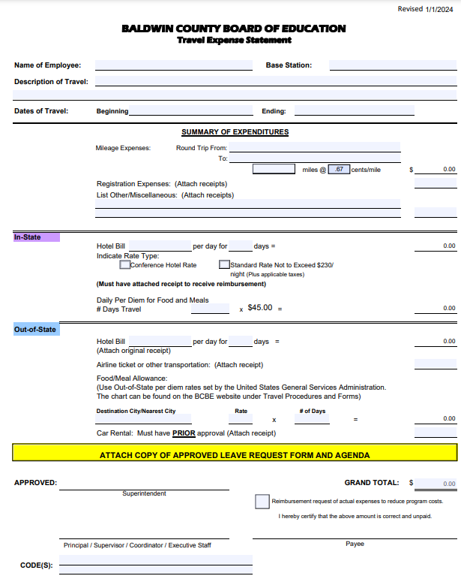
Employee Travel Reimbursements In/Out of State Travel
Current Form-Revision Date
Leave Request Form Required
Agenda Required
Legible Receipts Required
In State – Object 382
Purchase Order not required
Out of State – Object 383

Slide 10
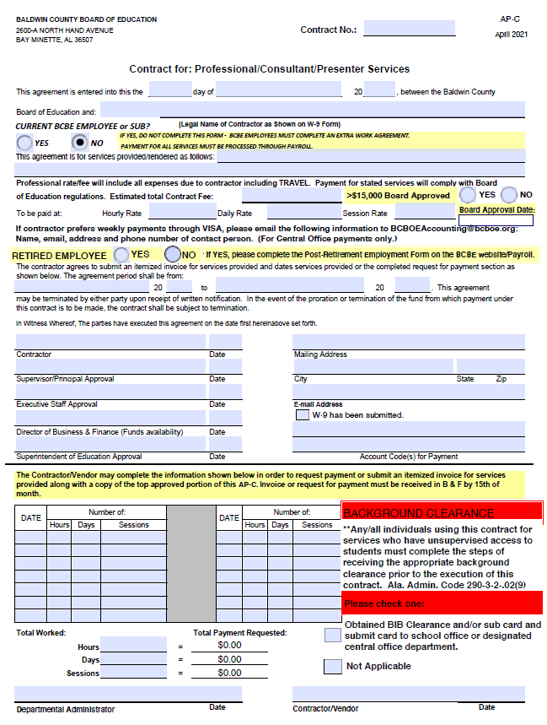
Contract for Professional Services
Paying an Individual
Request W-9
Complete Contract if applicable.
Contractor must sign form.
Cannot pay BCBE employee with local school check.
Bottom section of form can be used as the invoice.

Slide 11
P-Card Requirements 03
Signed Agreement forms Annually
Keep alphabetically in a binder by fiscal year.
Maintain Sign in/out log
Can be filed with monthly check documentation.
Completed Approval Form
For ALL P-Card purchases.
Detailed Invoice or Store Receipt
Must be signed by card user.

Slide 12
P-Card Approval Form
Employee completes prior to purchase.
Emails to executive secretary/bookkeeper requesting card.
Provides details and estimated amount.
Allows employee to reserve the card.
Express need to pick up and return on reservation date(s).
Available Funding in Activity prior to purchase.
Required Approvals prior to card use.

Slide 13
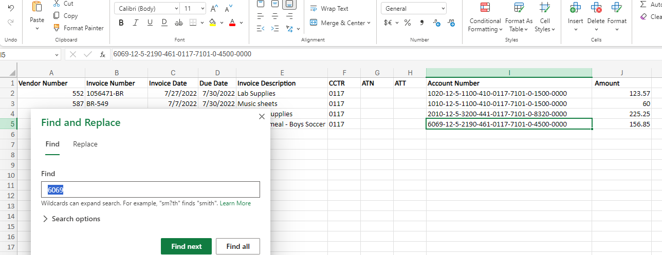
P-Card Best Practices
Agreement Forms
Keep alphabetically in binder
Sign In/Out
File with monthly check documentation.
Approval Forms
Submitted in advance.
Invoice Processing
Use Excel Spreadsheet to log purchases that do not require a PO.
Enter invoices with PO's in separate invoice batch.
Always "Proof" spreadsheet against actual invoices prior to importing.
Always "Proof" Invoice Batch Listing report with statement/invoices prior to merging.

Slide 14
Develop a School Process – Share the Workload
Issue Card
Agreement Forms
Sign In/Out
Documentation
Approvals
Collect Signed Invoice/Documentation
Log invoices on Shared Spreadsheet
NextGen
Import Spreadsheet / Enter Invoices
Print Check
Download Statement
Communicate to Staff!!!
Two People "Proof" Invoice Batch Prior to Merge.
7/24/2024
14

Slide 15
Summary
04
Approvals All purchases require approvals. | Documentation If it's not documented, it didn't happen!
We’re getting our work done Sharing the workload helps us to be more productive. | Communication Our expectations can only be met if we communicate them to others.

Slide 16
Closing
05
Questions???
Thank you for all that you do!
Donna
Ddaw@bcbe.org

